Slide 1
PhoneGap and Xamarin: Your Excuse to Not Write Your Mobile App is Gone
Jerrel Blankenship & Jamie Dicken

Slide 2
Who We Are
Jerrel Blankenship
@TheJerrel
Software Engineer at RelayHealth
Author: Pro Agile .NET Development with Scrum
Striving Software Craftsman
Certified Scrum Master
Jamie Dicken
@DotNetGeekette
Software developer and team lead at McKesson-RelayHealth
Mobile enthusiast
Volunteer at Per Scholas

Slide 3

I Only Want To Write It Once

Slide 4
Frameworks To The Rescue
PhoneGap
Xamarin
AppMobi
Unity
Appcelerator
Adobe Flex

Slide 5
PhoneGap

Slide 6
What Is PhoneGap?
Open-source
Single codebase
Support for iOS, Android, Windows Phone, Blackberry, webOS

Slide 7
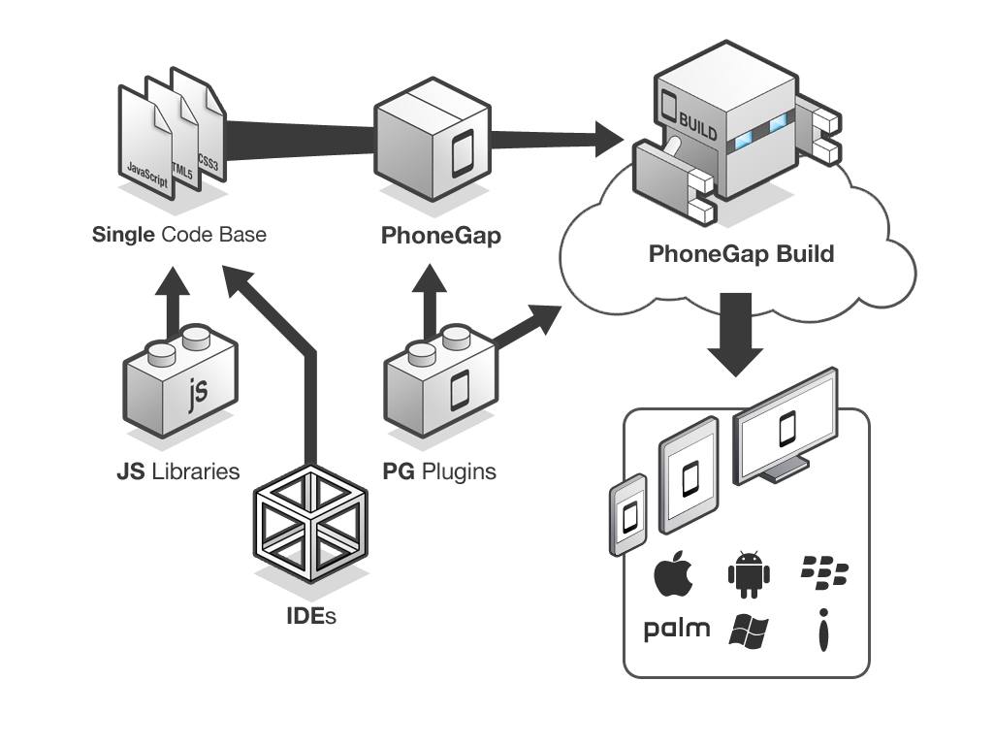
PhoneGap Overview
Notes:
Essentially, this is what the PhoneGap application creation process looks like. You take your IDE of choice as well as the javascript libraries you know and love, like jQuery mobile. You create one codebase, thereby eliminating the maintenance nightmares we face with redundant codebases. You wrap your html, css, and javascript files with PhoneGap, and you can take advantage of the PhoneGap plugins that interact with your device’s capabilities, like the camera and geolocation services. You send your app to PhoneGap build, and you end up with ready-to-submit app packages for each of the target platforms.

Slide 8
Let’s Create an App!

Slide 9
Testing a PhoneGap App
Notes:
When I’m developing for the web, for me, Chrome developer tools are second to none. So yes, while there are ways to debug Javascript in Visual Studio, I typically choose not to, and in my experiments with PhoneGap, I also chose to pursue an alternative route.
Fortunately, there’s a Chrome extension called the Ripple Emulator. The idea is that you can get a sense for how your app will look on different screen sizes, and you have the added benefit of being able to use Chrome’s Javascript debugging tools.
With the Ripple Emulator, you can view any website or any app, provided that it has been deployed to a URL your computer can reach. In Visual Studio, I can open my solution as a web site, run that locally using Chrome, and enable Ripple.
One caveat with the Ripple Emulator – it really should be used only to debug Javascript. While you’ll see your app in what looks like an iPhone 4, the emulator unapologetically doesn’t render your app the same way an iPhone would. As always, before deploying your app to an app store, you’ll want to test it on an actual device.

Slide 10
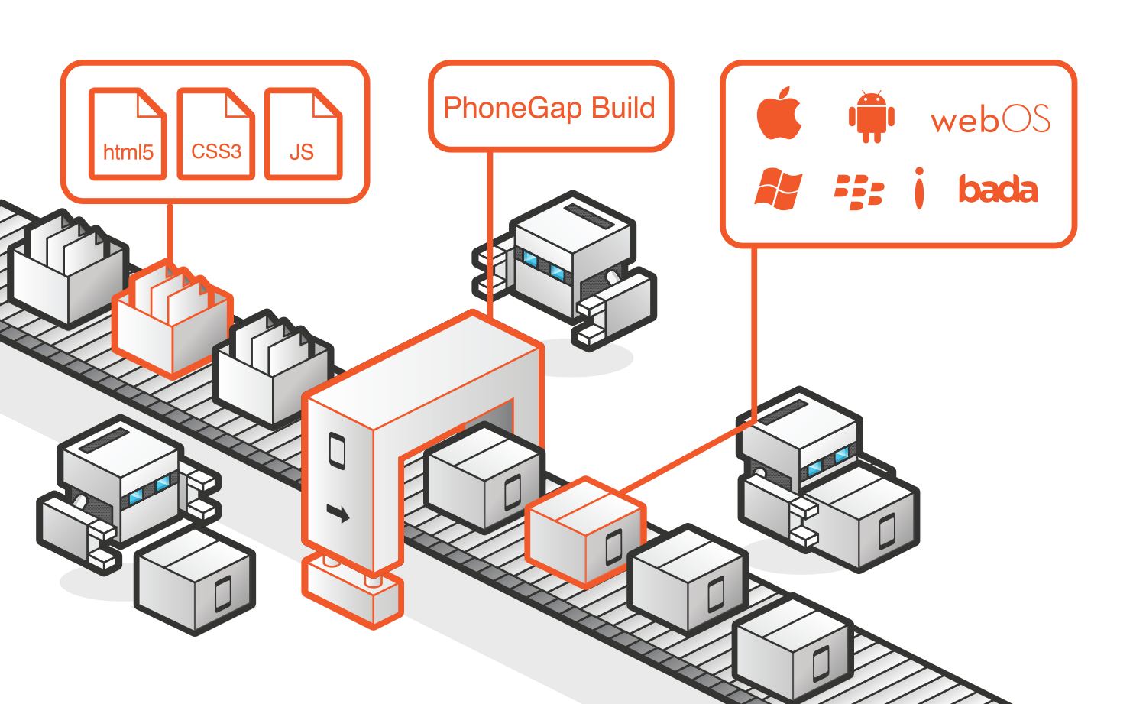
PhoneGap Build

Slide 11
Xamarin

Slide 12
Xamarin Details
Cross-platform development with C#
Can develop Android and iOS apps
iOS requires network connection to Mac
Create native apps using Native APIs
Compiled code
Use any existing .NET Libraries
Visual Studio Integration

Slide 13
PhoneGap v. Xamarin: Which do I choose?
Notes:
Jamie: Now that we’ve shown you two tools for cross-platform mobile development, the question becomes “which one should I use?”
Jerrel: Clearly, both of these tools allow you to easily create an app to deploy to all of the major app stores, so it really comes down to what you’re trying to accomplish.
Jamie: Let’s take a look at the advantages and disadvantages of each.

Slide 14
Key Considerations
Cost
Performance
Supported platforms
Native app experience

Slide 15
Questions?
Notes:
Jamie: Well, there you have it – two very different tools for creating cross-platform mobile applications. One leverages your web skills of HTML, CSS, and Javascript. The other allows you a cleaner way to have a different user interface per platform, easily making your apps seem much more targeted per environment and therefore enhancing the user experience.
Jerrel: And with that, your excuse to not write your mobile app is gone!

Slide 16
Contact Us
Jerrel Blankenship
@TheJerrel
www.jerrelblankenship.com
Jamie Dicken
@DotNetGeekette
www.dotnetgeekette.com

Slide 17
Image Attributions
Diagram - PhoneGap Overview by Adobe / Yohei Shimomae
Diagram - PhoneGap Build by Adobe / Yohei Shimomae
Smart Phone, Tablet, and PC – The Droid Guy

